Slide 1
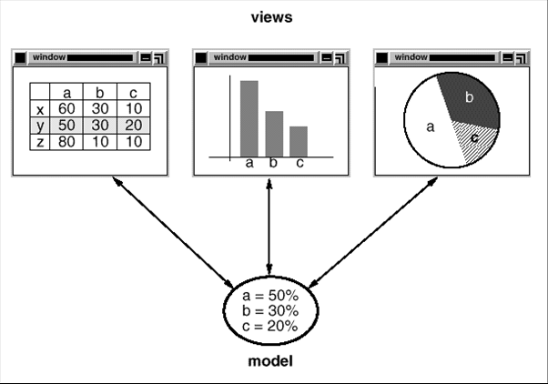
Motivation: Observer

Slide 2
Observer
Intent | Define a one-to-many dependency between objects so that when one object changes state, all its dependents are notified and updated automatically.
Problem | Encapsulate the core (or common or engine) components in a Subject abstraction, and the variable (or optional or user interface) components in an Observer hierarchy.
Notes:
One objecgt hocche youtube channel ta
And all its dependents hocche subscriber gula

Slide 3
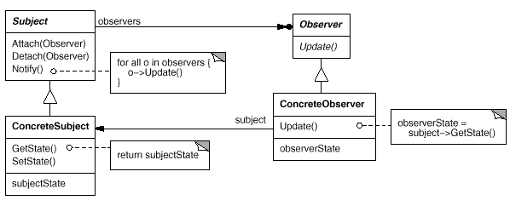
Solution

Slide 4
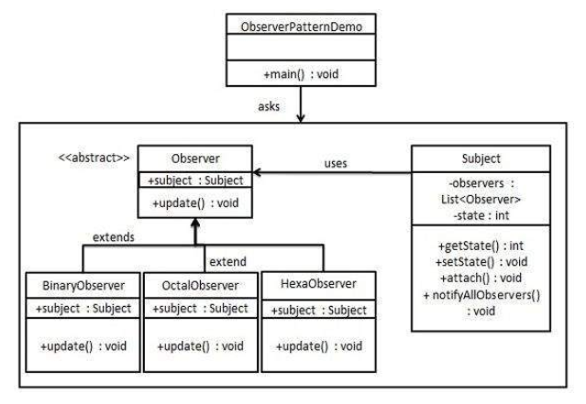
Notes:
Subject hocche youtube channel ta
Ar observer hocche subscriber gula

Slide 5
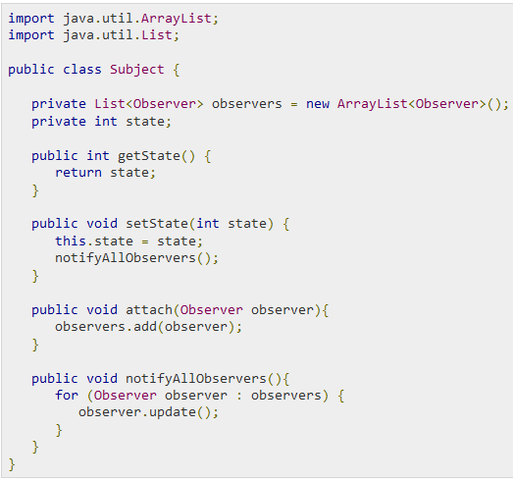

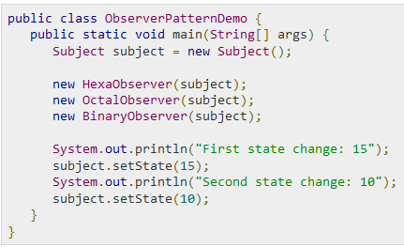
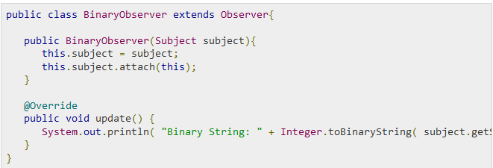
Notes:
Subject hocche youtube channel ta

Slide 6
Consequences
Decoupling subject and observer
Support broadcast communication

Slide 7
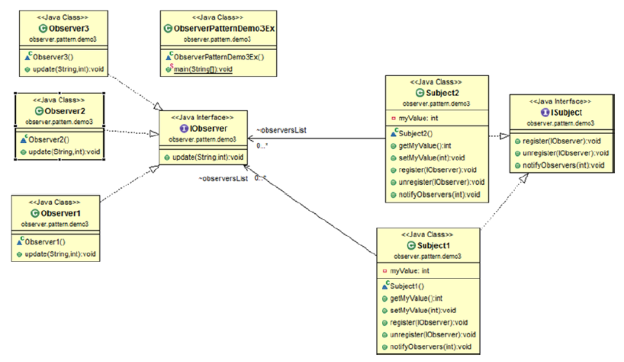
Many observers, many subjects
Notes:
Many to many relation hole

Slide 8
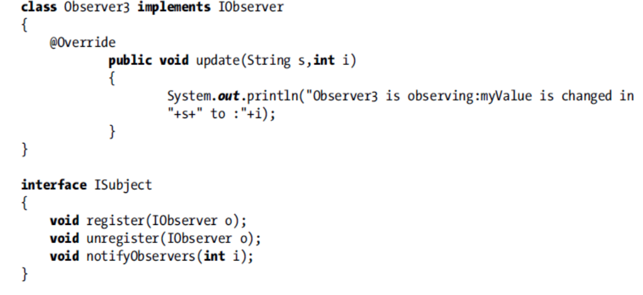

Slide 9
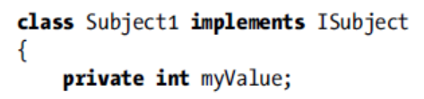
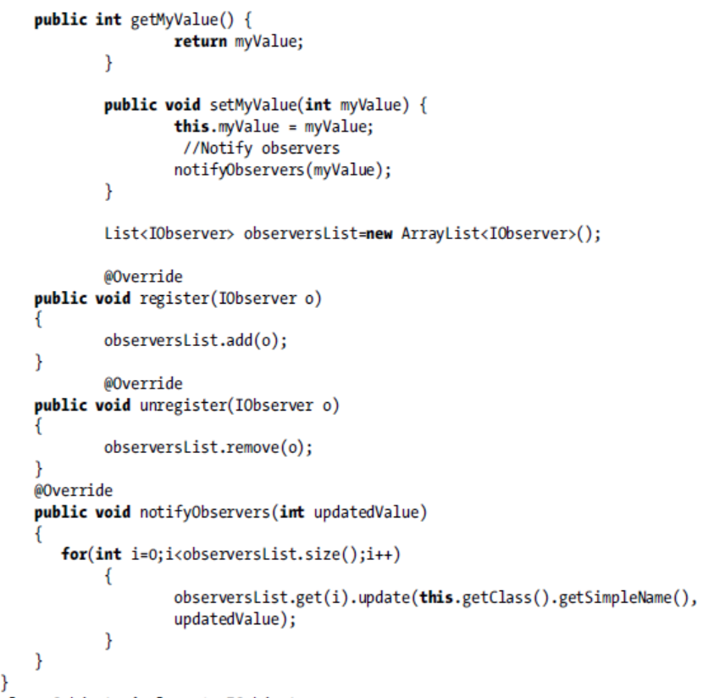

Slide 10
